Slide 1
Introduction to Cloud
Session 01
Course : COSC6100001 - Cloud Infrastructure
D6825 - Samuel Philip

Slide 2
Learning Objectives
At the end of this session, the student will be expected to :
Explain about what is cloud computing
Understand cloud computing ethical issues
Understand Network-centric Computing and Network-centric Content

Slide 3
Outline
Cloud Computing Overview
Energy Use and Ecological Impact of Cloud Computing
Cloud Computing Ethical Issues
Factors Affecting Cloud Service Availability
Network-centric Computing and Network-centric Content

Slide 4
Cloud Computing Overview

Slide 5
“a model for enabling ubiquitous, convenient, on-demand network access to a shared pool of configurable computing resource that can be rapidly provisioned and released with minimal management effort or service provider interaction”
(US National Institute of Standards and Technology)

Slide 6
On-demand self-service
Broad network access
Resource pooling
Rapid elastic
Measured service

Slide 7
Cloud Types
Provisioned for open use for the public by a particular organization who also hosts the service
Used for a single organization, can be internally or externally hosted
Public Cloud
Private Cloud
Hybrid cloud
Community Cloud
Composed by two or more cloud types
Shared by several organization, typically externally hosted, but may be internally hosted by one or more of the organization involved
Notes:
Public Cloud – the infrastructure is made available to the general public or a large industry group and is owned by an organization selling cloud services.
Private Cloud – the infrastructure is operated solely for an organization, It may be managed by the organization or a third party and may exist on or off the premises of the organization.
Hybrid Cloud – the infrastructure is a composition of two or more clouds (private, community, or public) that remain unique entities but are bound together by standardized or proprietary technology that enables data and application portability (e.g., cloud bursting for load-balancing between clouds).
Community Cloud – the infrastructure is shared by several organizations and supports a specific community that has shared concerns (e.g., mission, security requirements, policy, and compliance considerations). It may be managed by the organizations or a third party and may exist on premises or off premises.

Slide 8
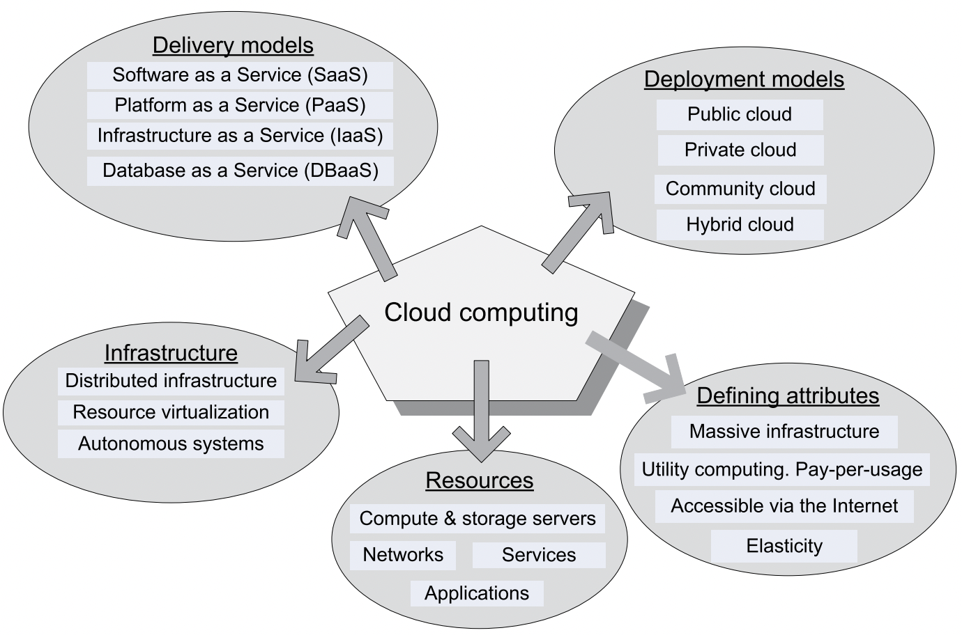
Cloud overview
Other than characteristic and types…
cloud computing consist of a ton of other parts that work together

Slide 9
Energy Use and Ecological Impact of Cloud Computing

Slide 10
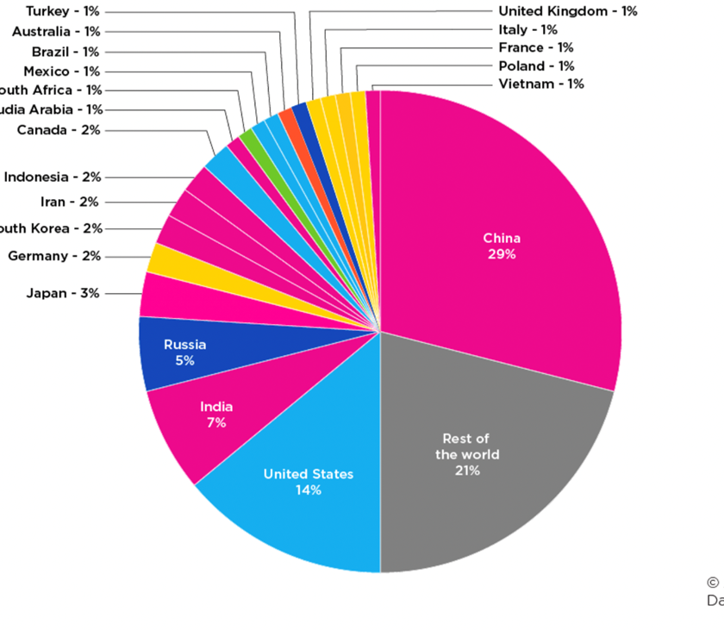
Energy Use and Ecological Impact of Cloud Computing
The CO₂ Contribution of Various Countries of the World
This is data from 2021, can you guess how much of this emission was caused by datacenter energy use? Imagine how the graph would look like ever since AI like ChatGPT enter the space.

Slide 11



How Cloud Data Centers Contributes to Lowering
CO2 Emission?
Cleaner energy sources like Solar could help
Efficient hardware - Reducing wasted energy and having more energy spent on running the IT equipment rather than cooling
Delivering IT service wherever needed, by shifting workloads to enable greater use of renewable resources.
Again. Another efficiency steps

Slide 12
Ethical Issues in Cloud Computing

Slide 13
Paradigm Shift Elements of Cloud Computing
Control
Control is relinquished to third party services
Data sovereignty
Data is stored on multiple site administered by several organizations
Network
Multiple services interoperate across the network

Slide 14
Cloud Service Availability

Slide 15
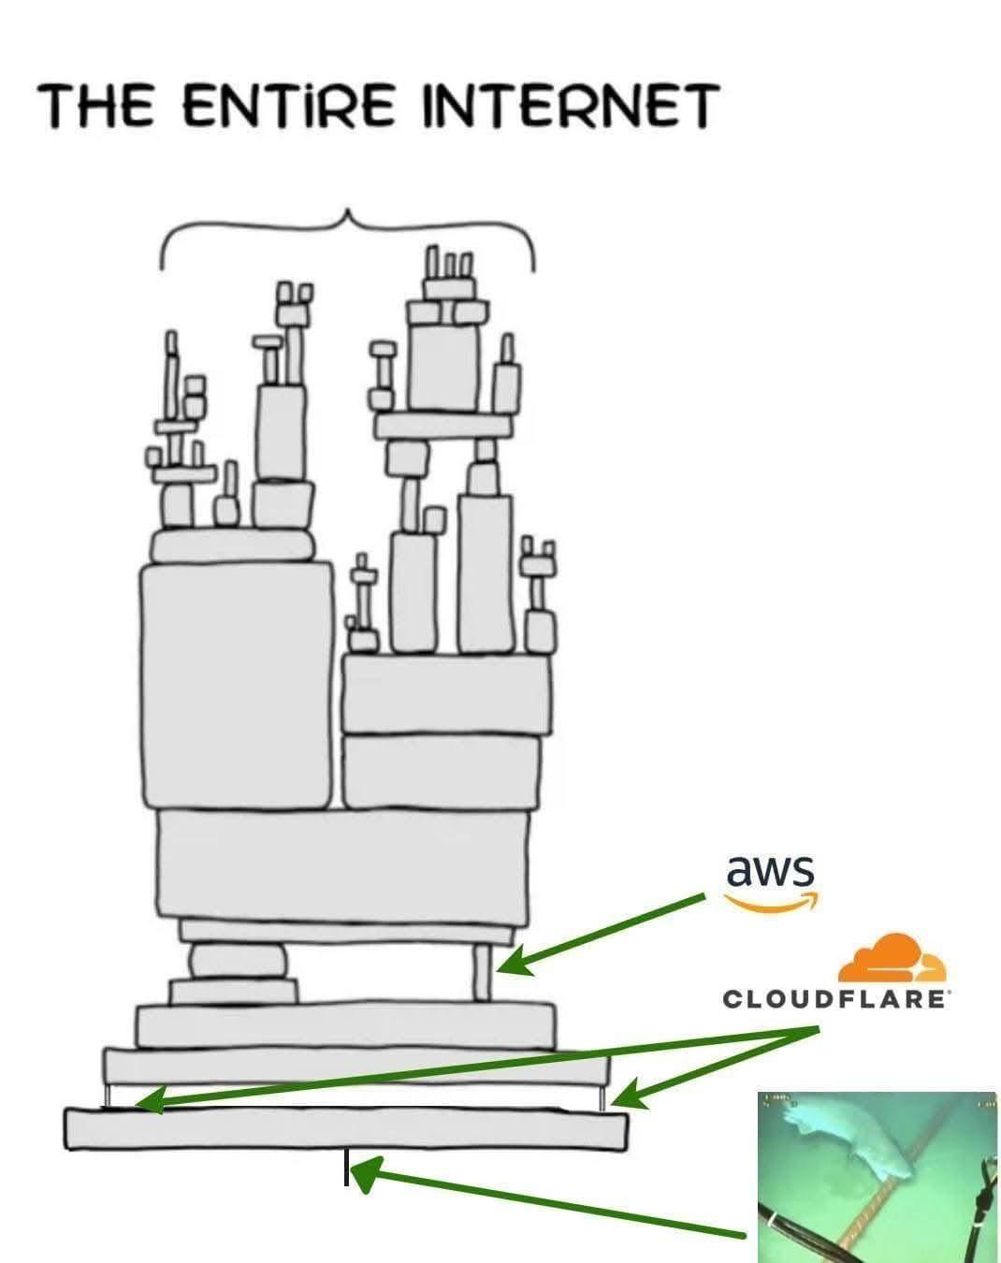
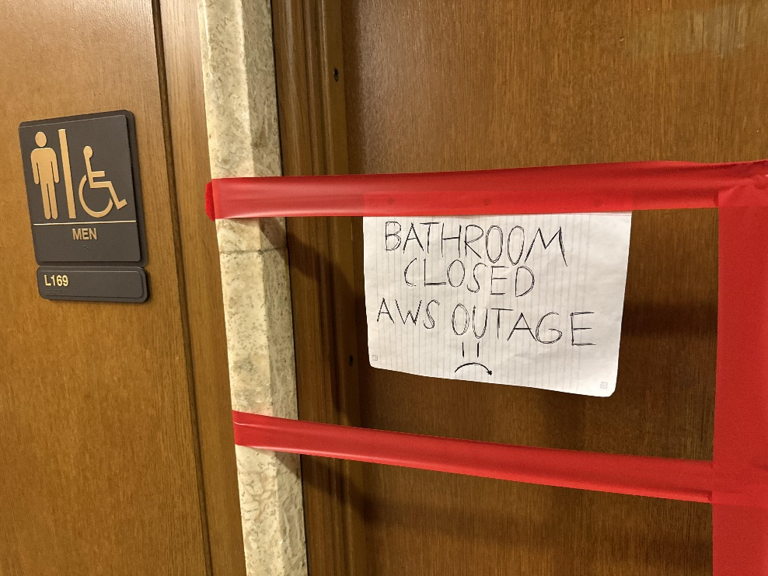
Cloud availability
There are factors that affects cloud availability, small mistakes could halt the entire operation.
Remember when AWS and/or Cloudflare went down in Q4 2025?
Or when a shark bite Google’s underwater fiber optic cable?
Some smart toilets remembers that outage

Slide 16


Cloud availability
sada
On a more serious case,…
March 2, 2018: Equinix Power Outage Behind AWS Cloud Disruption
power outage at the Equinix data center was blamed for connectivity problems that temporarily silenced Amazon’s smart assistant Alexa and disrupted operations for some AWS customers, including Atlassian, Twilio, and Capital One.

Slide 17
Network-centric Computing and Network-centric Content

Slide 18
Characteristics
Most applications are data intensive
Computing and communication resources (CPU cycles, storage, network bandwidth) are shared , and resources can be aggregated to support data-intensive applications
Data sharing facilities collaborative activities
Virtually all application are networks intensive
The systems are accessed using thin clients running on systems with limited sources

Slide 19
Characteristics
Those paradigm shift causes some concern
The management of large pools of resources poses new challenges because such systems are vulnerable to malicious attacks that can affect a large population of users
Large-scale systems are affected by phenomena characteristic to complex systems such as phase transitions when a relatively small change in the environment can lead to an undesirable system state

Slide 20
Characteristics
Those paradigm shift causes some concern
Ensuring Quality of Service (QoS) guarantees is extremely challenging because perfect performance isolation and the ability to accommodate workloads with very large peak-to-average ratios are elusive
Data sharing poses not only security and privacy challenges but also requires mechanism for access control for authorized users and for detailed logs of the history of data changes.

Slide 21
Exercise
Find article related to implementation of Cloud Computing Technology
Find cases related to QoS problem of Cloud services

Slide 22
References
Marinescu, Dan C. (2022). Cloud Computing Theory and Practice: 3rd Edition. Morgan Kaufmann Publishers. ISBN: 978-0-323-85277-7
https://www.ucsusa.org/resources/each-countrys-share-co2-emissions

Slide 23
Thankyou

